Slide 1
Needfinding
HCI Assignment 1
Autumn 2015

Slide 2
The Team
Rhea Dookeran (GSB)
Dennis Ellis (GSB)
Tanner Gilligan (CS)
Amanda McNary (CEE/CS)
Interest: Travel

Slide 3
Our Interviewees
Katie, early-20s female
Jonathan, mid-30s male
Rajan, late-20s male

Slide 4
Our Interviewees
Katie, early-20s female “Millennial” representative
Jonathan, mid-30s male “Working Age” representative
Rajan, late-20s male “Young Entrepreneur” representative
Notes:
No payment, no incentive other than request for a conversation

Slide 5
The Interview
Shallow:
“Can you tell me about the longest trip you’ve taken?”
“What type of traveler are you?”
“Have you had any travel horror stories?”

Slide 6
The Interview
Deep:
“Why do you find airports to be intimidating?”
“For what reasons do you avoid packaged group activities?”
“How did you spend your time instead of sightseeing in India?”

Slide 7
Results: Katie
Thumbs-Up to: sightseeing, monuments
Thumbs-Down to: airports, transit
Surprise: gets anxious about airports even with (because of?) little exposure to them

Slide 8
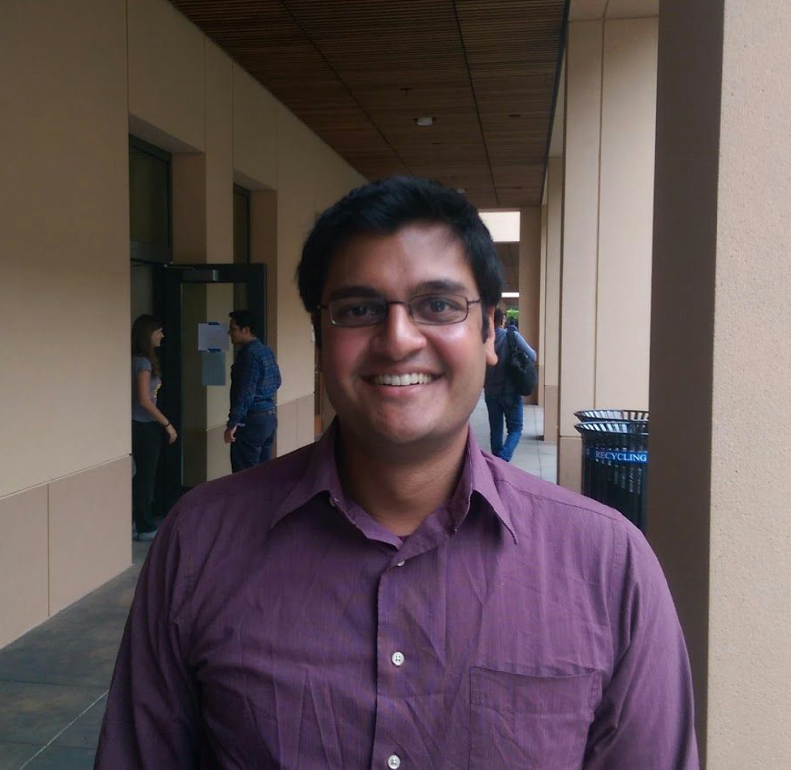
Results: Rajan
Thumbs-Up: unexpected encounters, quality sleep, local sights
Thumbs-Down: work-traveling, spotty WiFi, scheduling
Surprise: wants to be better at maintaining routines but dislikes working abroad

Slide 9
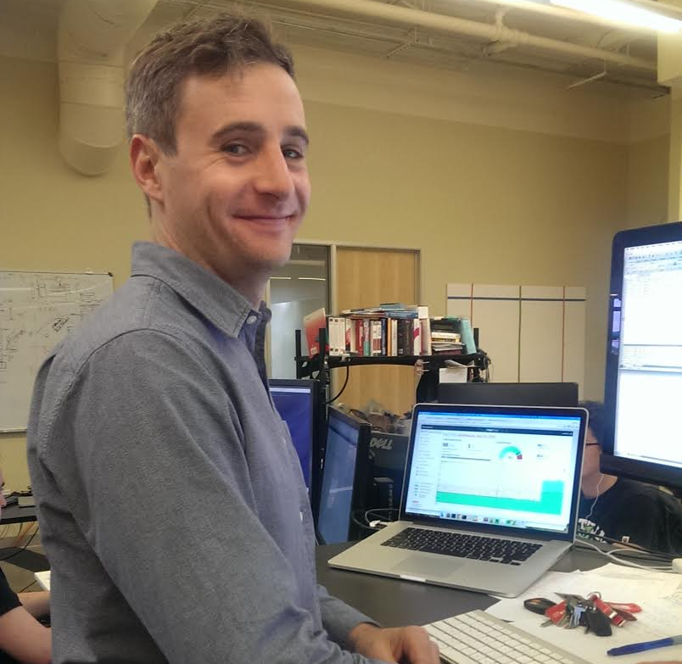
Results: Jonathan
Thumbs-Up: walks, active activities, food, new experiences
Thumbs-Down: waiting, car rentals, travel time, group tours
Surprise: has given into planning time, though he dislikes it

Slide 10
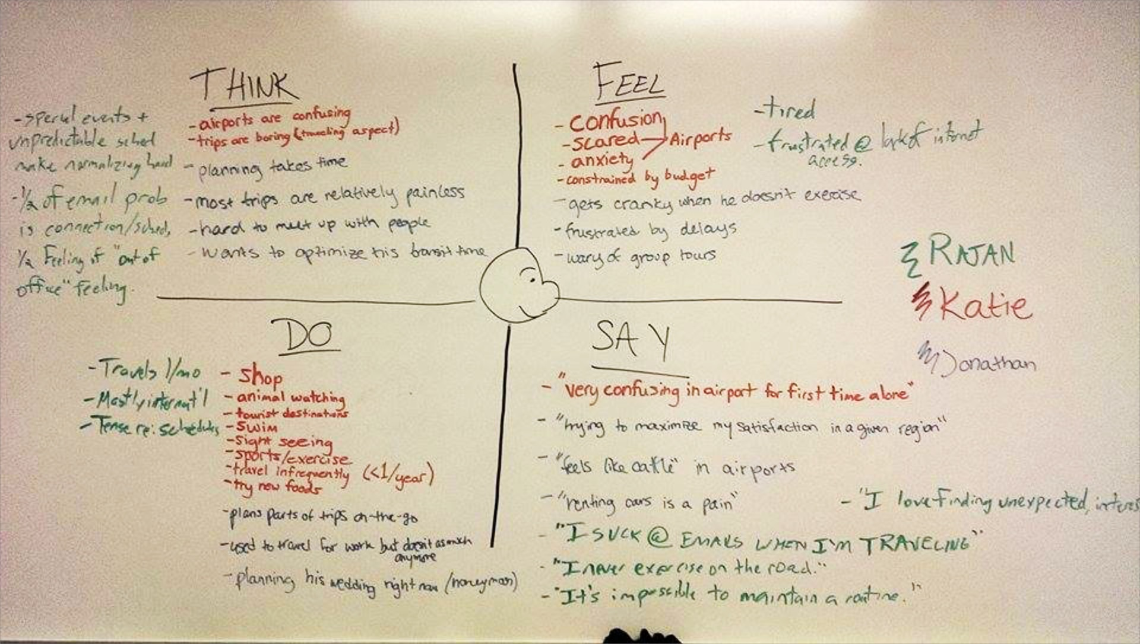

Slide 11
SAY “I’m trying to maximize my satisfaction.” “It’s impossible to maintain a routine.” “Being in an airport for the first time is confusing.” “I suck at emails while traveling.” “Motels are often sketchy.” “I love finding unexpected stuff.” “Airports make me feel like cattle.” | FEEL Excited for new, unexpected experiences. Confusion from airports. Nervous about missing flights. Tired from poor sleep. Frustration from language and cultural barriers. Stressed about canceled activities. Restricted by money. Relaxed because out of the office.
DO Planning a honeymoon. Avoiding work while abroad. Traveling to shop and see tourist sites. Traveling for pleasure. In-country traveling. Tensing up while thinking about scheduling. Running for exercise abroad. Stressing about WiFi and schedules. Trying new food. | THINK Business travel is fun once in a while. Sight seeing is fun. Car rentals are unreliable. Special/unforeseen events make normalizing hard. Planning is important but takes too much time. Actual traveling is boring. New people are exciting. Traveling is usually painless.
Notes:
fdsaf

Slide 12
Initial Needs and Insights
Time management is key and planning helps, but sticking to a schedule is hard
Travelers need comfortable access to reliable information

Slide 13
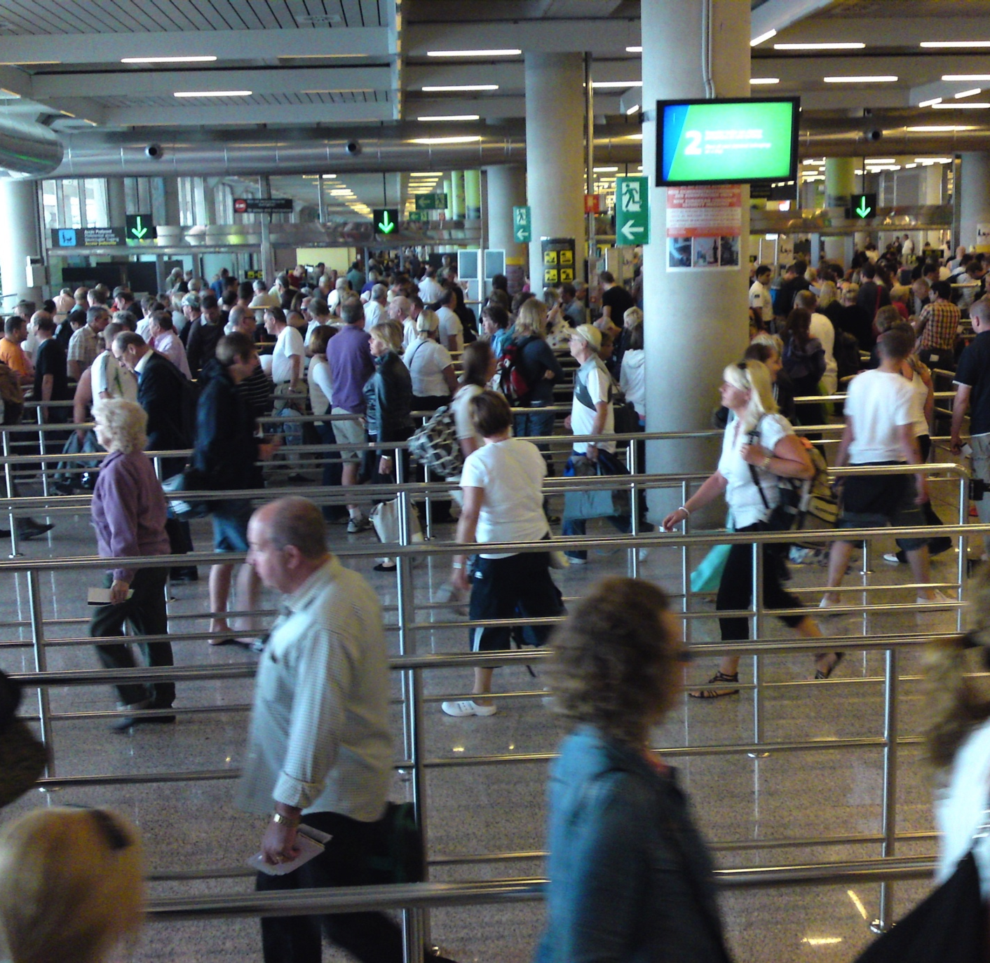
Summary
Traveling: common experience with common inconveniences
Everyone hates flying.
Notes:
https://www.flickr.com/photos/kalleboo/3536493996/in/photolist-6ovssq-bcX2rc-7uZ3CJ-7wFfvr-uGzZa-torPq-nWeHwA-7rFsRq-PL6Ft-nFMAw2-8z6SfE-7CXXQu-6kiZ6f-9wZYsS-89BMpg-8QbAEQ-5yTN6R-BMEB-2juvBD-7CUgA6-7wQnMt-4Pud5x-29iPNZ-3yTksP-5DewYJ-8YofGD-4wCZkT-jbFKs-r4u3Kf-a44ivb-aCVafh-i2Cuy-5UXcos-8fLECs-4SGEEb-7t8Lw2-w7CNbD-deK3mW-6jdHz1-2owb9A-6fHxpd-g25bXa-8vPbD6-pUVFjW-KwCsB-6wiyQg-4CP21a-atFUaL-5ebXrc-bvg2nh

